Slide 1

Pseudocode & Flowcharts

Slide 2
Pseudocode
1

Slide 3
Pseudocode
What is pseudocode?:
An informal coding practice to help programmers plan algorithms and train programmatic thinking.
Not tied to any specific programming language such as Python, JavaScript, or C#. Instead, it uses human languages.
A way to plan every step of your program without worrying about syntax.
Its greatest benefit is to allow you to discover the vulnerabilities and opportunities of your programmatic logic in order to improve it before implementation.

Slide 4
Do’s and Don’t of Pseudocode
Do’s
Use proper naming conventions
Indentations and white spaces are the key
Keep it simple
Keep it concise
Don’ts
Don't make your pseudo-code abstract
Don't make it too general

Slide 5
Example 1
Write a program that asks the user for a temperature in Fahrenheit and prints out the same temperature in Celsius.

Slide 6
Example 1
Pseudocode:
x = Get user input
y = Convert x to Celsius
Output message displaying Celsius temperature
#precise temperature
x=input('Please input a temperature in Fahrenheit.')
y=(float(x)-32)*5/9
print('Your temperature in Celsius is: %s.' %y)

Slide 7
Example 2
Write a program that converts from Fahrenheit to Celsius or from Celsius to Fahrenheit, depending on the user's choice.

Slide 8
Example 2
x = input "Press 1 to convert from Fahrenheit to Celsius or Press 2 to convert from Celsius to Fahrenheit."
y = input ask what number?
z = choice
if z = 1 (1 is pressed)
do f to c conversion
print output
elif z = 2 (2 is pressed)
do c to f conversion
print output
else
print "Please enter either 1 or 2"

Slide 9
Flowcharts
2

Slide 10
Flowcharts
A flowchart is a type of diagram that:
represents the workflow or process of an algorithm.
shows the steps as symbols of various kinds, and their order/sequence by connecting them with arrows.
is a visual representation of data flow.
is useful in writing a program or algorithm and explaining it to others or collaborating with them on it.
you can use a flowchart to spell out the logic behind a program before even starting to code the automated process.
can help to organize big-picture thinking and provide a guide when the time to code comes.

Slide 11
The use of Flowcharts
Flowcharts are useful to:
Demonstrate the way code is organized.
Visualize the execution of code within a program.
Show the structure of a website or application.
Understand how users navigate a website or program.

Slide 12
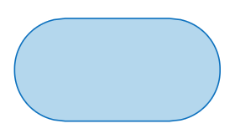
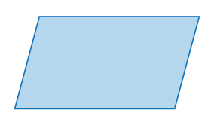
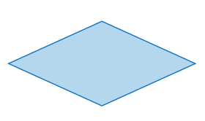
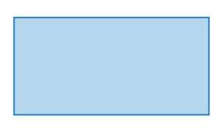
Elements of the flowchart
The building blocks of a flowchart are (for more click here):
Terminal
Data/IO
Arrow
Decision
Process

Slide 13
Elements of the flowchart
The building blocks of a flowchart are (for more click here):
Start
user = input()
if k <= 0.8
X = 3
Y = 3/2
Y = Y**2
Terminal
Data/IO
Decision
Process

Slide 14
Example of the flowchart
Write a program that picks n random names from a list

Slide 15
Example of a flowchart
Start
list_of_names = []
number_names = n
Yes?
Sample
Sample > n
Assign samples to output list
Stop and return
No?

Slide 16
The End

